Slide 1

Group 8
Member:
Ngo Hoan Tam Huy - CE140548
Ngo Nguyen Hong Hai Long - CE140007
Tran Hoang Qui – CE140632
Tran Ngoc Man Huy - CE140289
Mentor:
Mr. Vo Hong Khanh

Slide 2
01
Table of Contents
02
03
04
05
Topic
Use case
Side map
Theme
Demo
06
Q&A

Slide 3
01
Topic

Slide 4
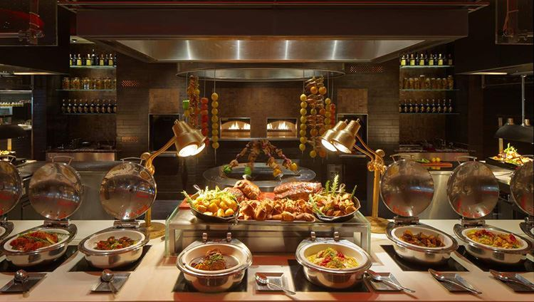
1 Topic
Nowadays, buffet restaurant is a trend. Therefore, buffet restaurants are often so crowded that sometimes there are no tables left. Feast Egg was born to solve this problem. We can book a table through the app and also choose the date with the food we like to reserve the table.

Slide 5
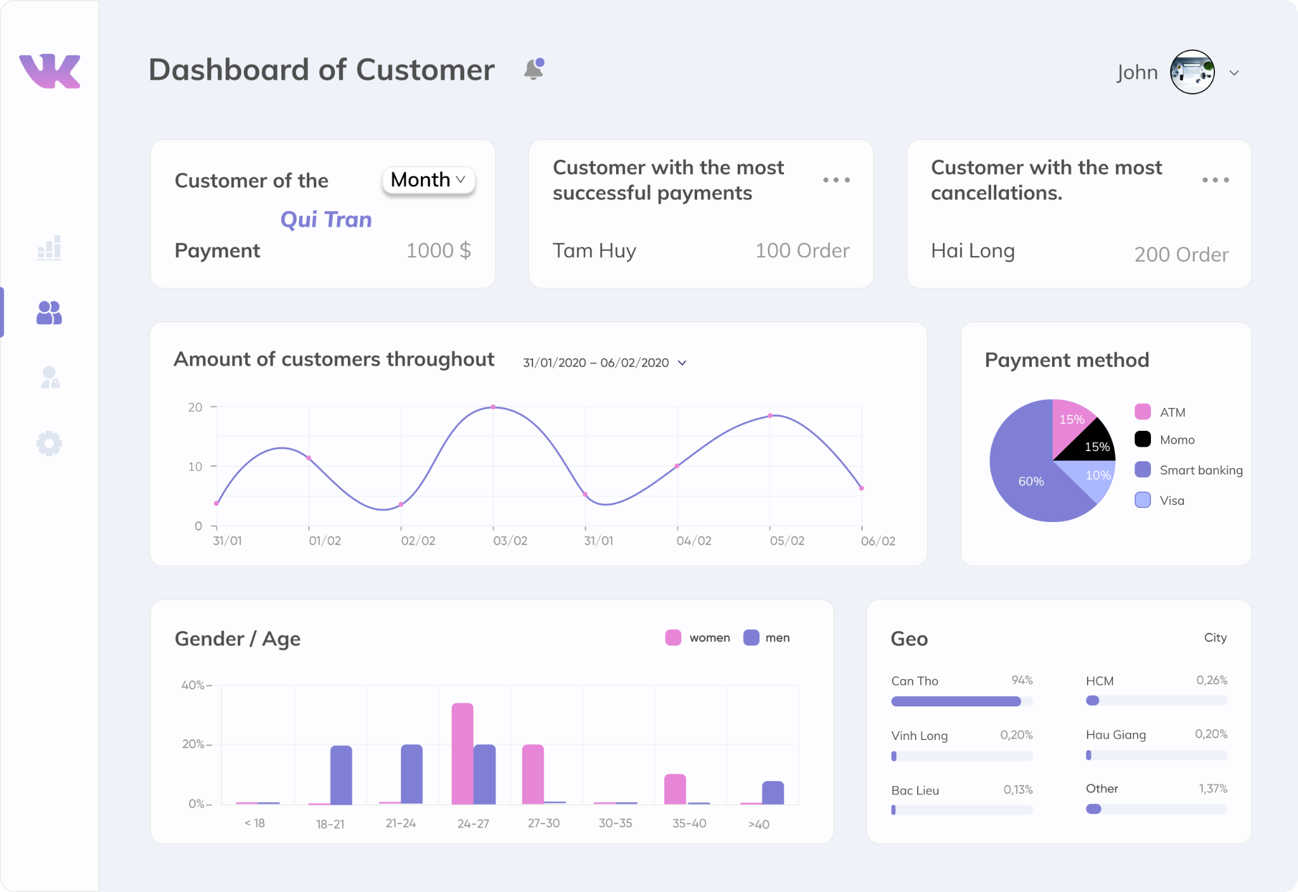
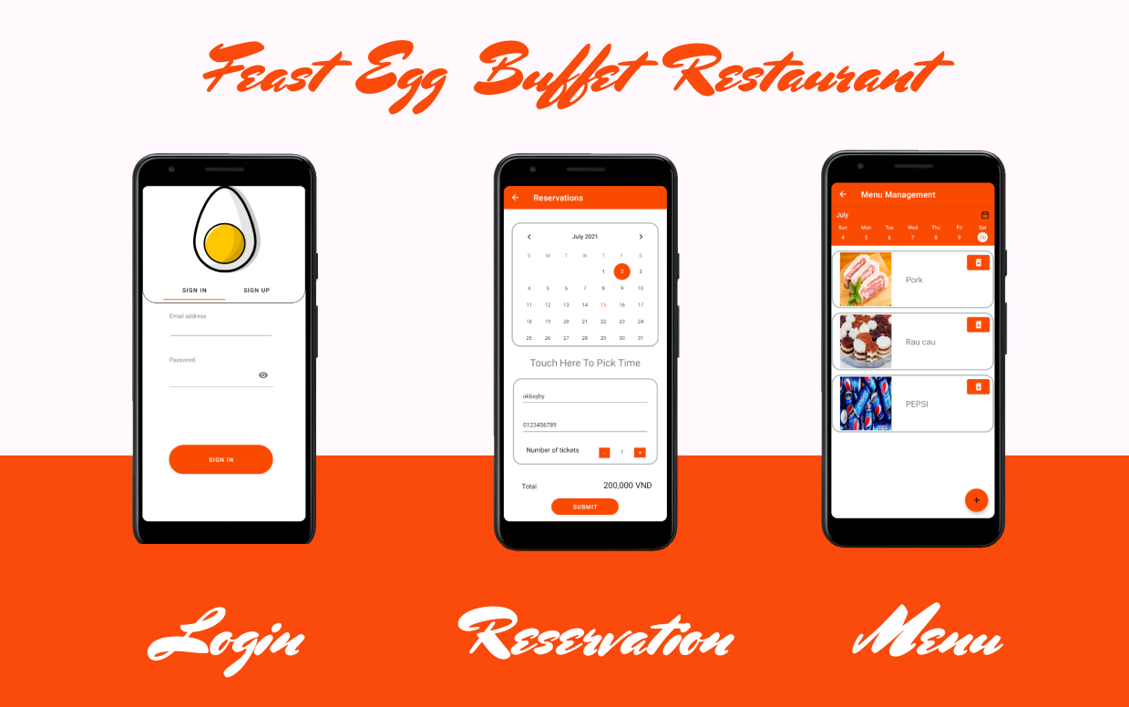
1 Topic
Feast Egg Buffet Restaurant app
Feast Egg Buffet Restaurant mobile application that help users booking table for their meals .
Feast Egg web app help managing restaurant activities
Feast Egg Managing Tools

Slide 6
02
Use case

Slide 7
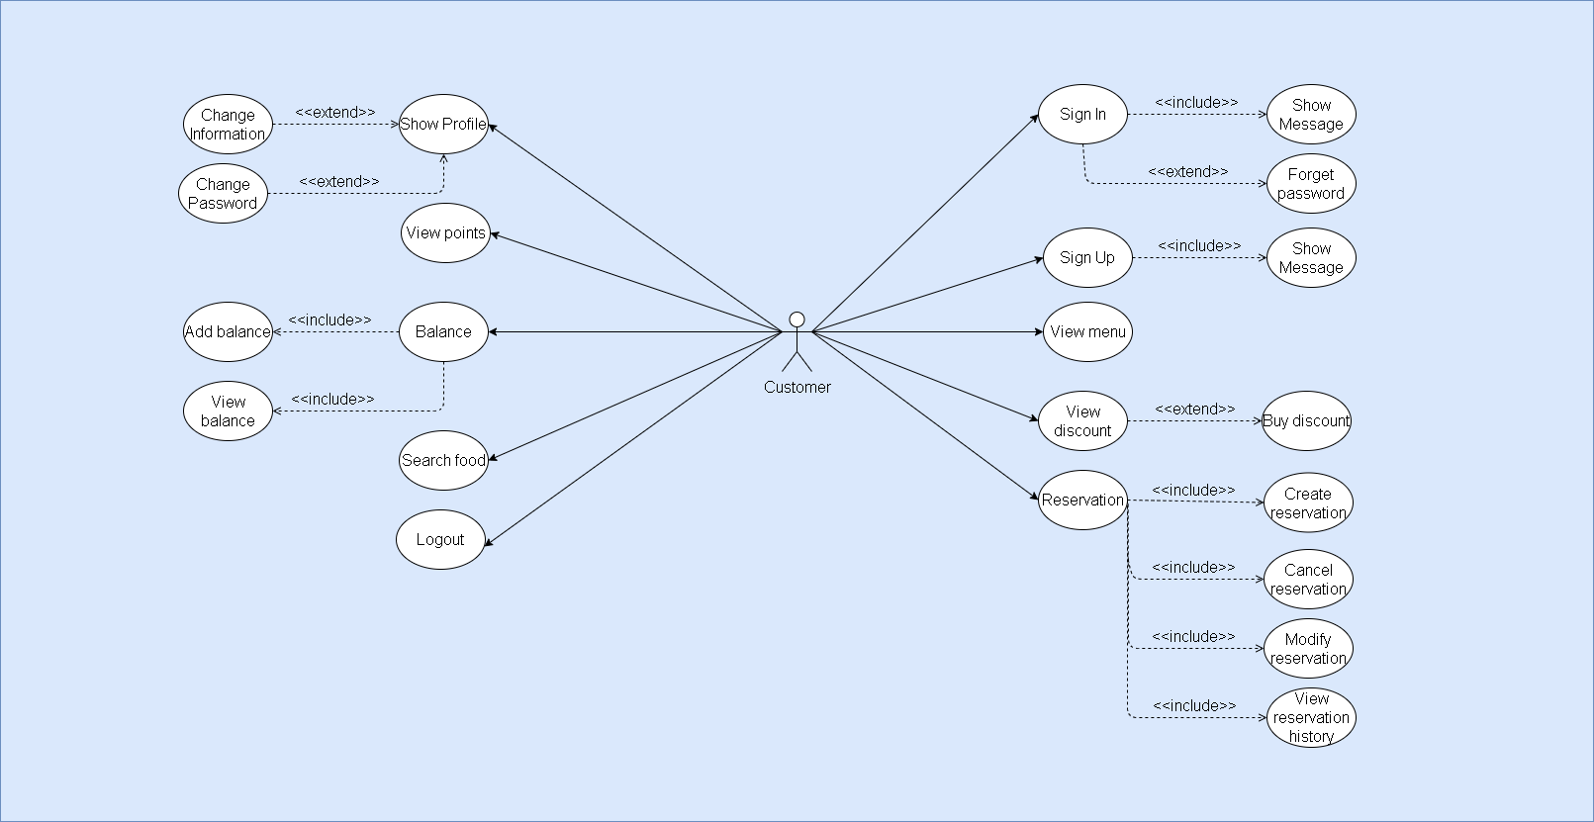
2.1 Customer
Customer use case

Slide 8
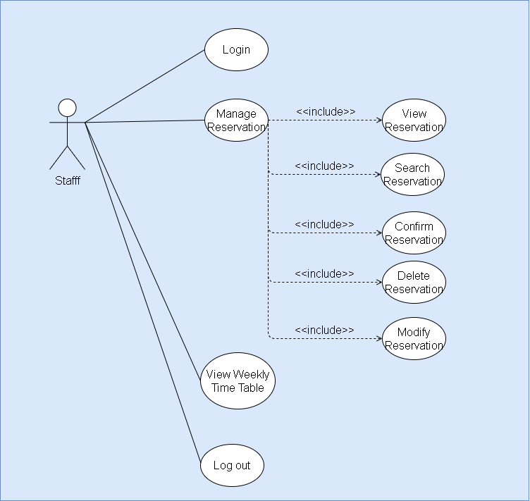
2.2 Staff
Staff use case

Slide 9
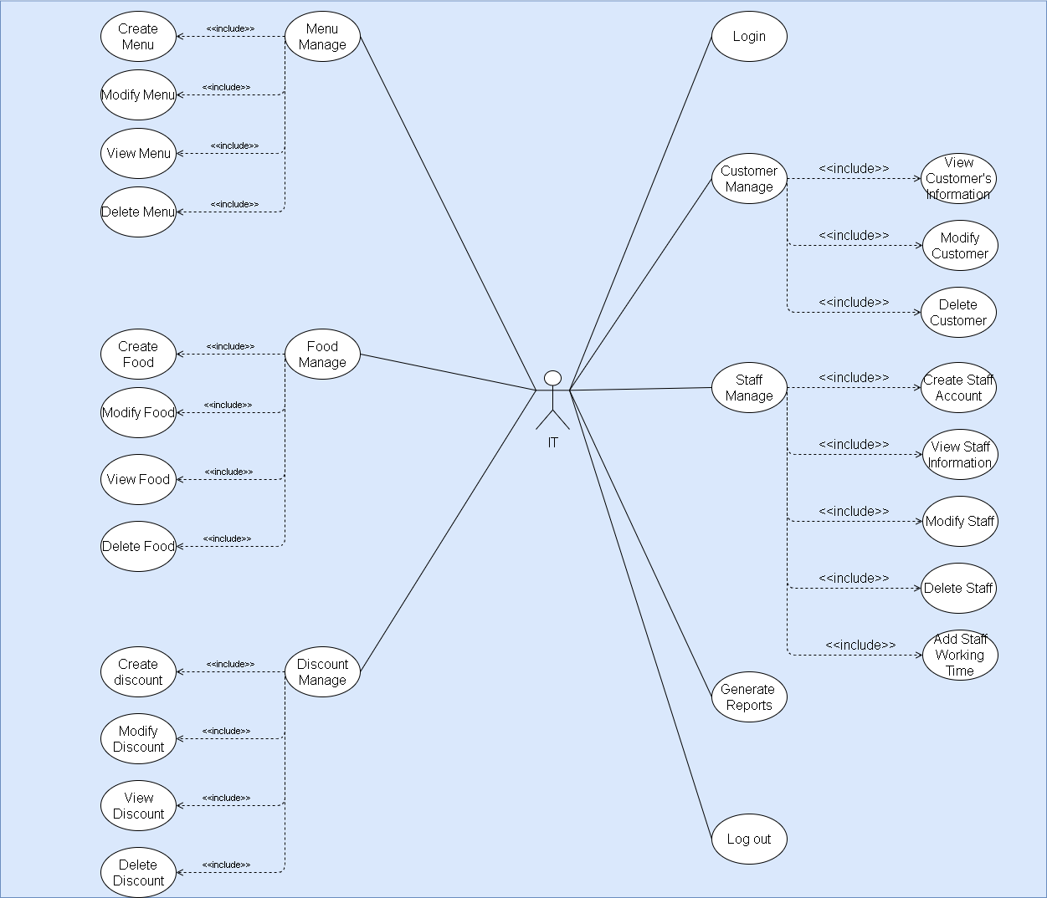
2.3 IT
IT use case

Slide 10
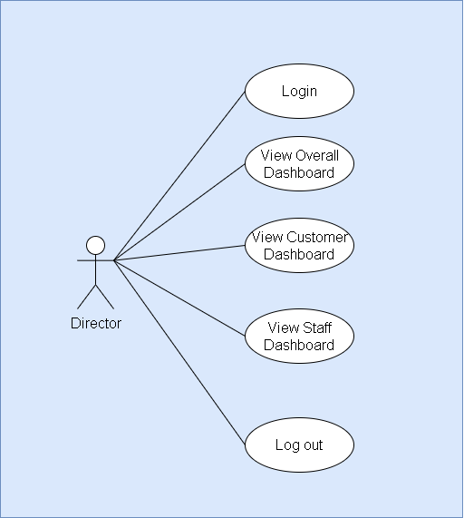
2.4 Director
Director use case

Slide 11
03
Side Map

Slide 12
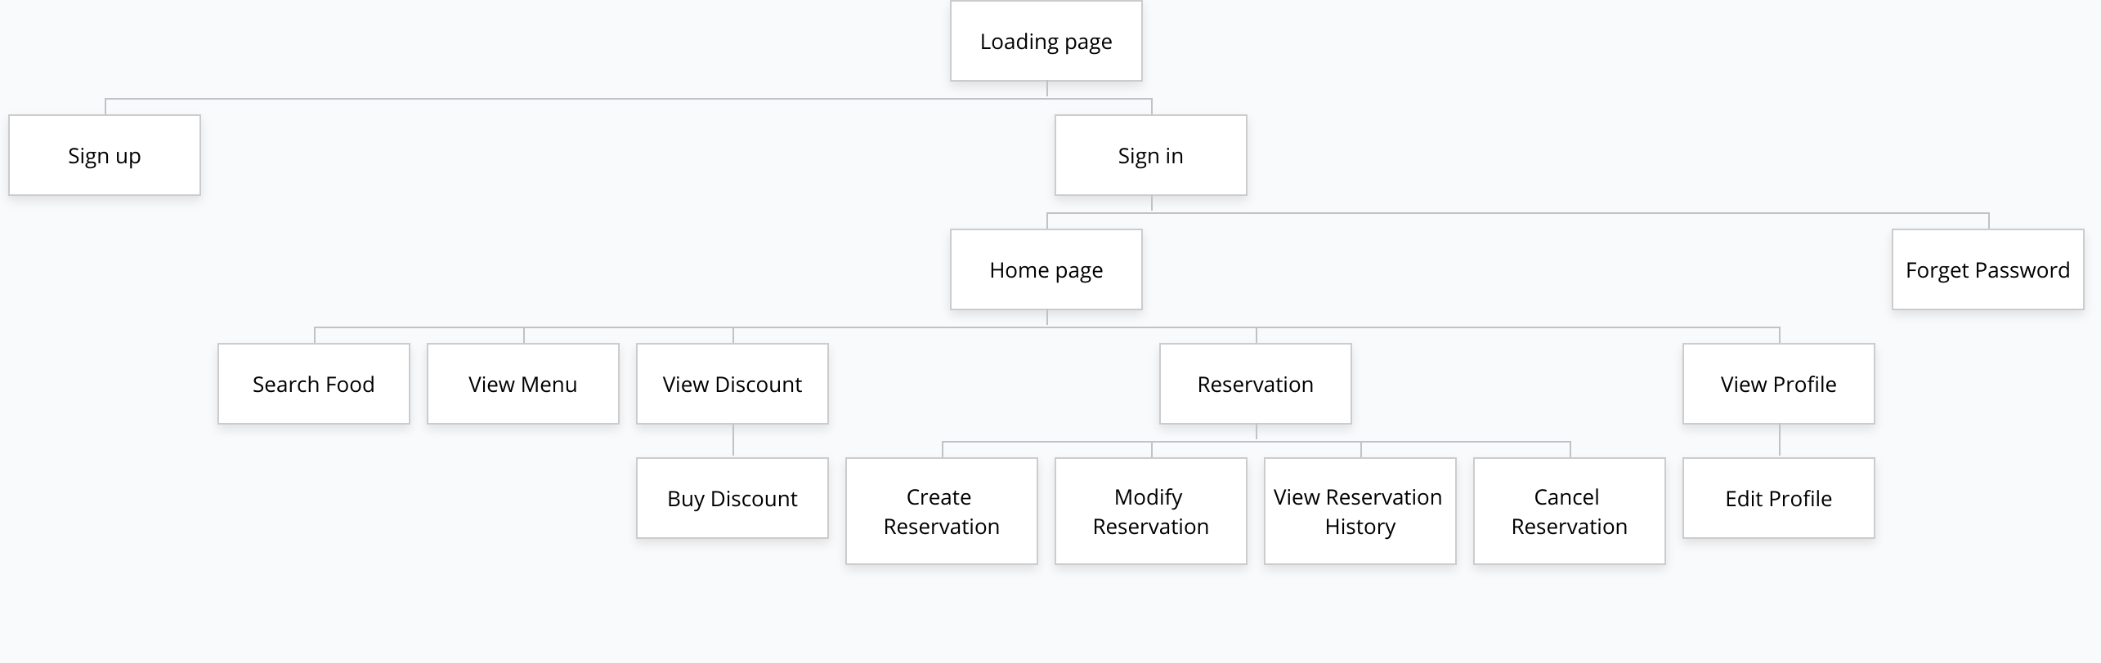
3.1 Customer side map
Customer side map

Slide 13
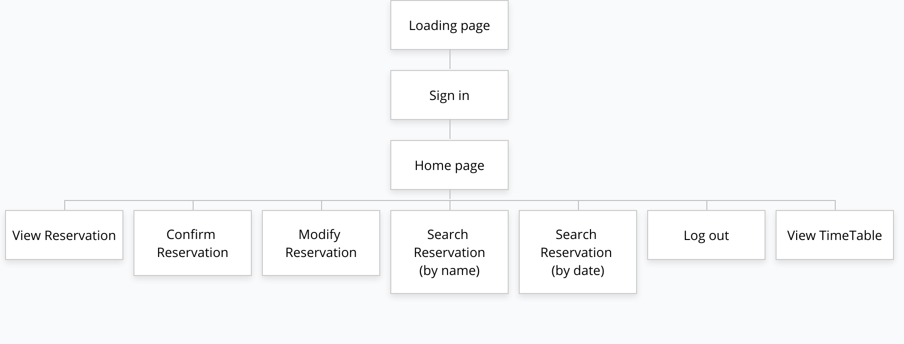
3.2 Staff side map
Staff side map

Slide 14
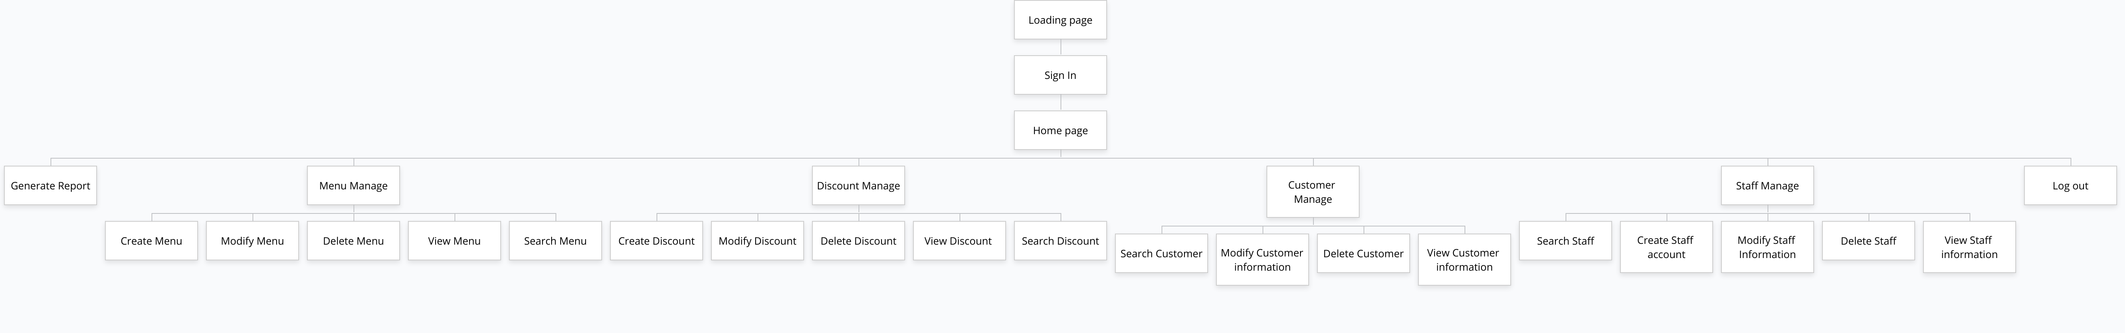
3.3 IT side map
IT side map

Slide 15
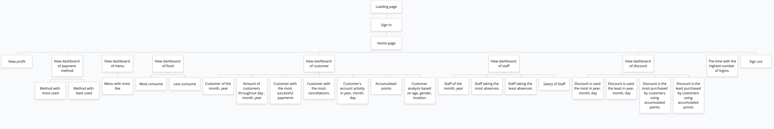
3.4 Director side map
Director side map

Slide 16
04
Theme

Slide 17
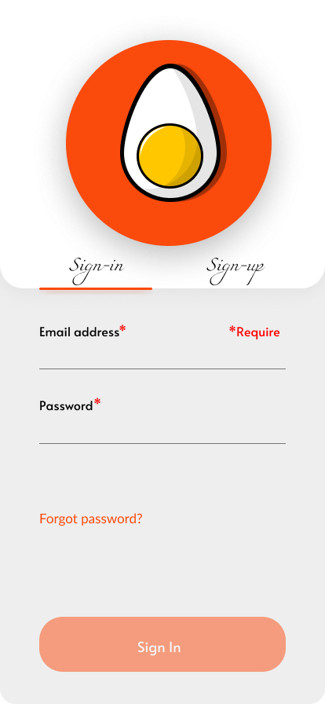
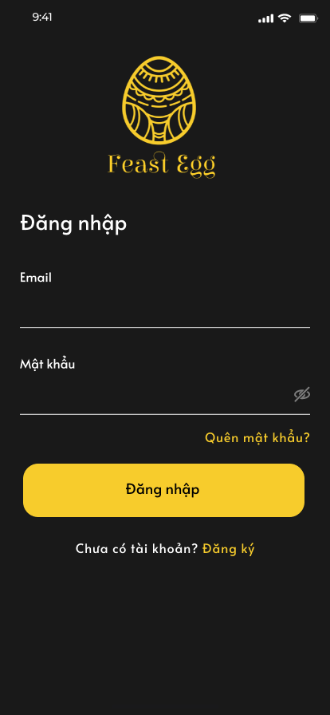
4.1 Customer theme
Theme 1
Theme 2

Slide 18
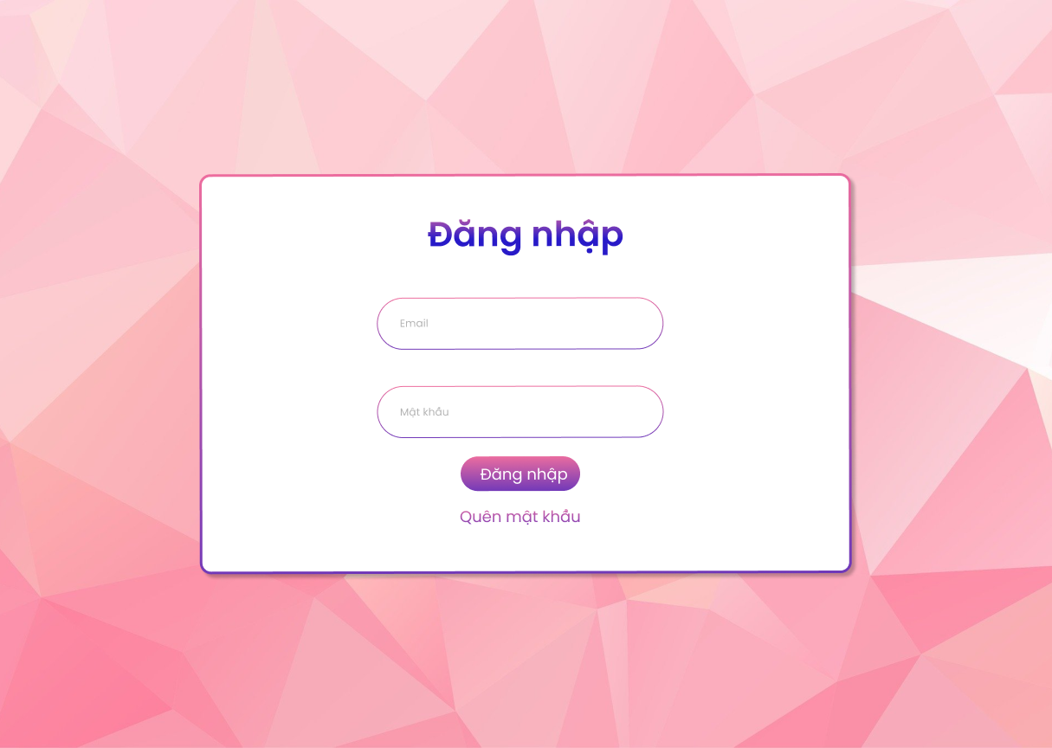
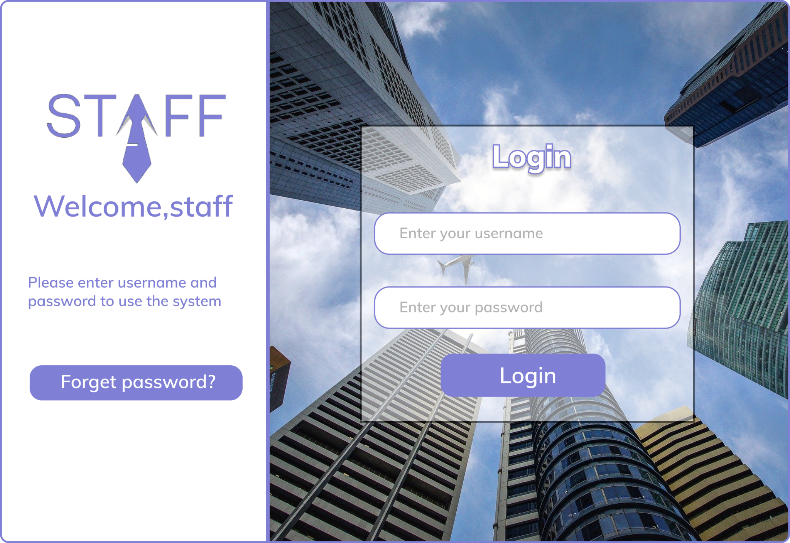
4.2 Staff theme
Theme 1
Theme 2

Slide 19
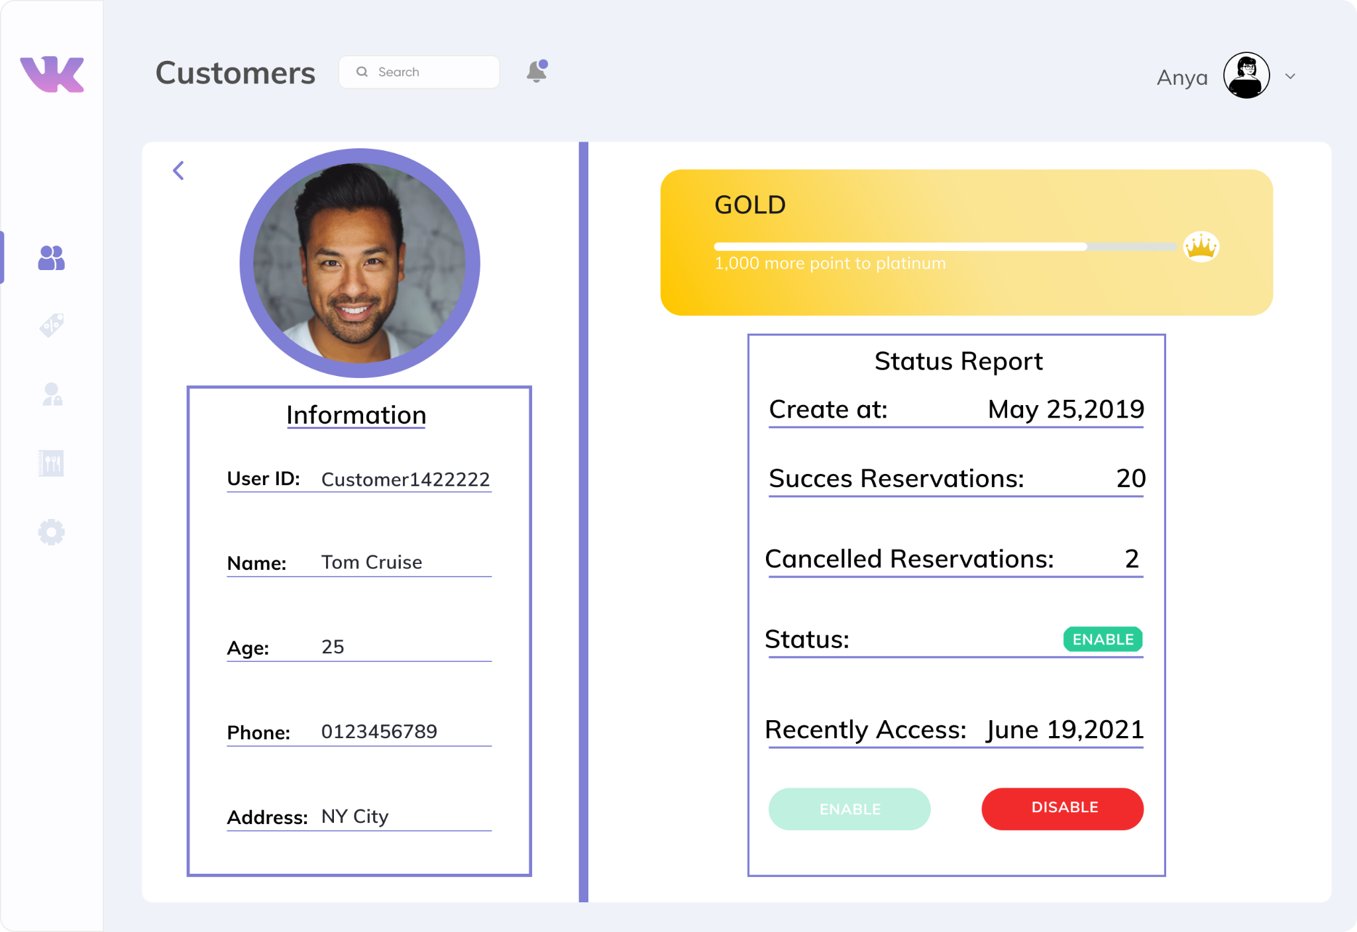
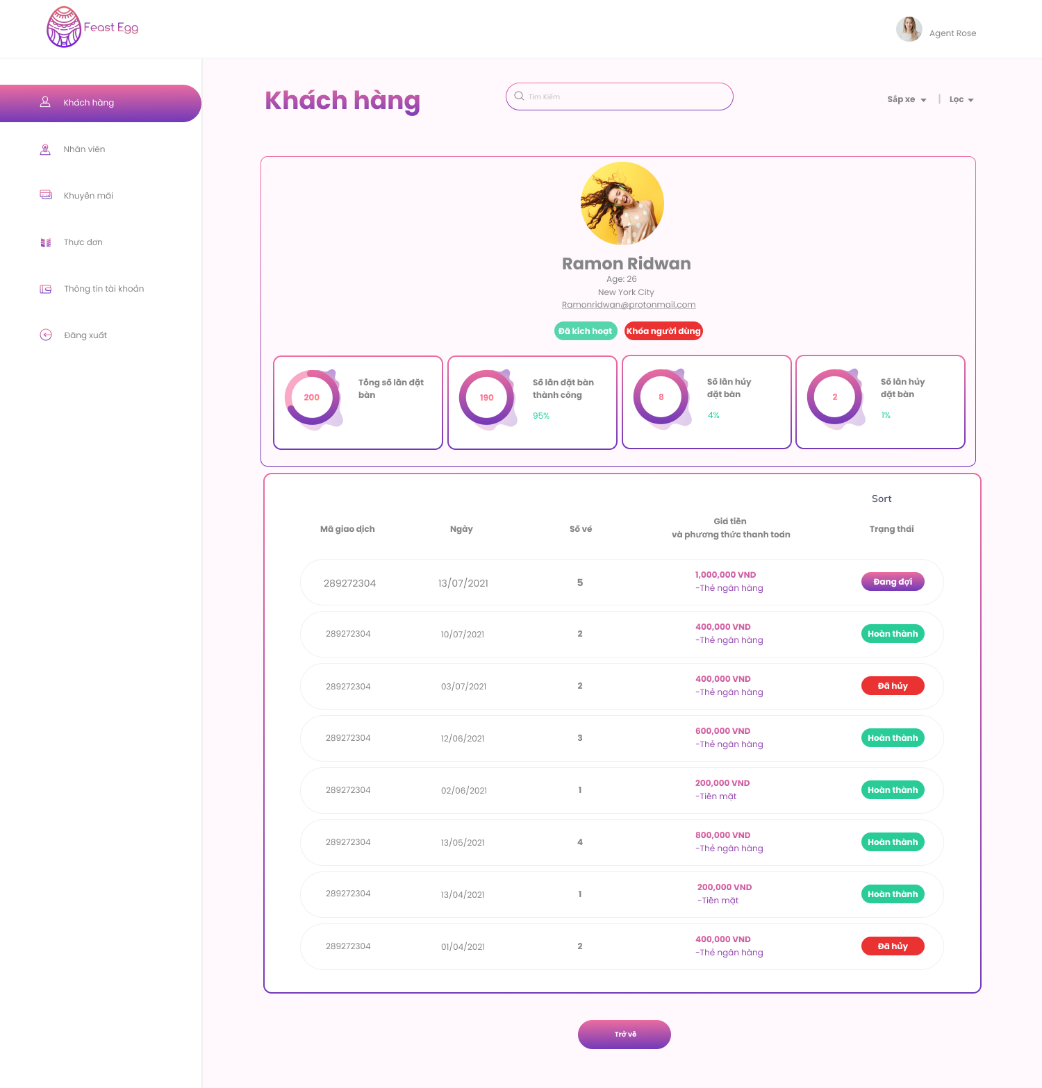
4.3 IT theme
Theme 1
Theme 2

Slide 20
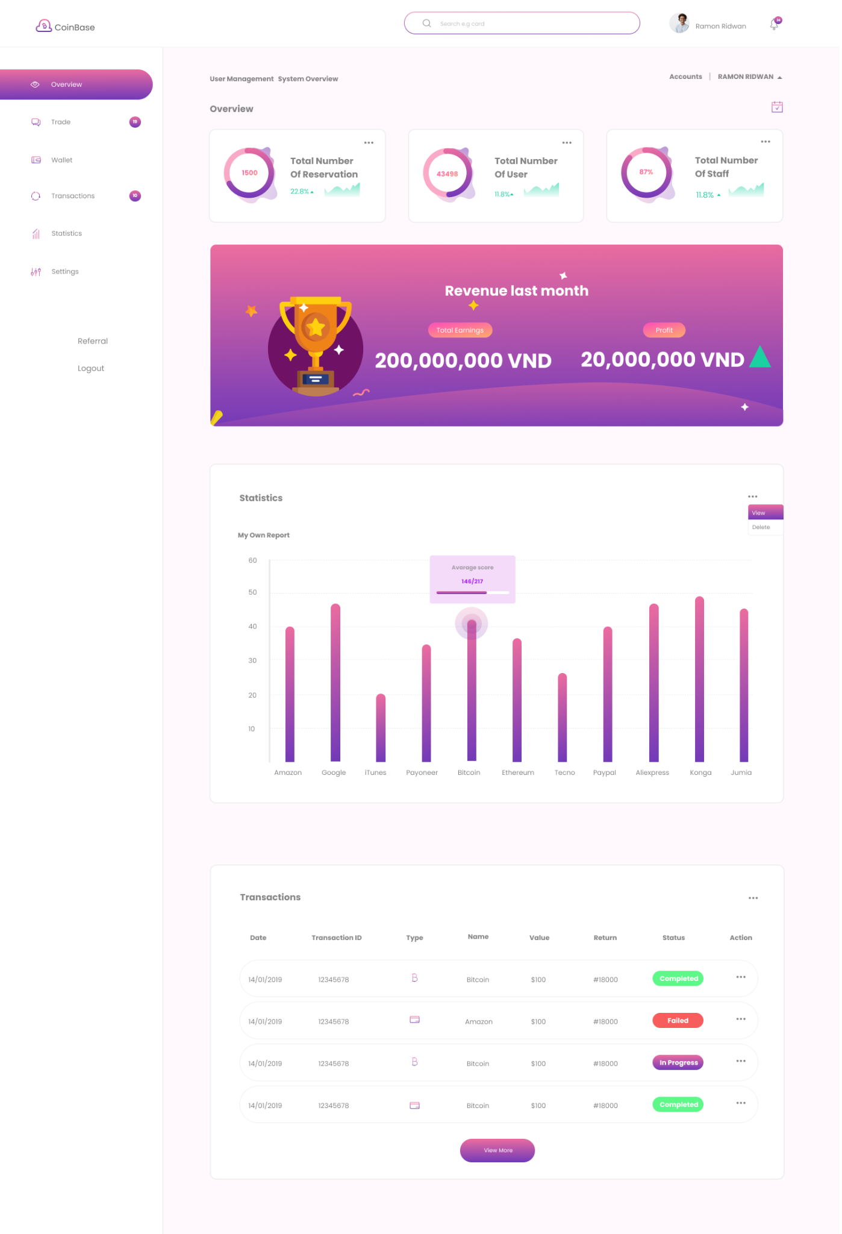
4.4 Director theme
Theme 1
Theme 2

Slide 21
05
Demo

Slide 22
06
Q&A

Slide 23
Thanks!

